Slide 1



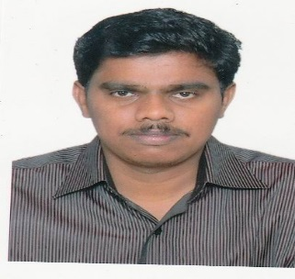
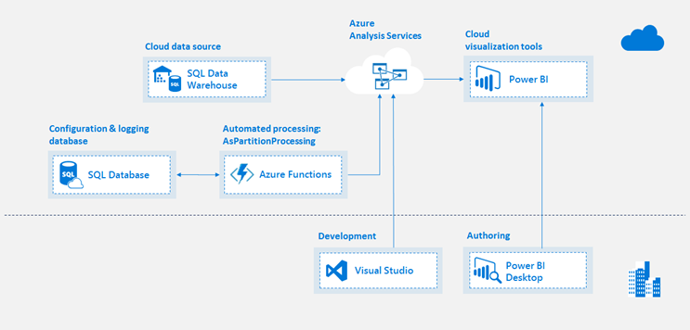
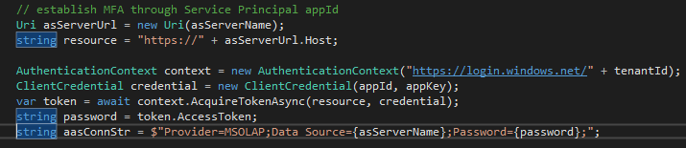
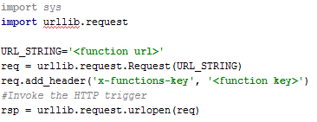
Azure Analysis Services
Microsoft BI-focal lens
Automating the Processing of Azure Analysis Services(AAS)
Automating the processing of AAS cubes and it’s partitions is not straightforward and as easy as “on-prem” cubes which leverage the SQL Server Agent jobs. This article talks about high level steps to process AAS by leveraging AAS AMO objects through Azure functions which can be called through HTTP Request in a scheduler or can be scheduled within the Azure function app.
Daniel J Arumugam has 13 years of IT experience and his core skills are MSBI tools. He has worked on designing and implementing end-to-end BI solutions leveraging the entire MSBI tools stack.
Typical AAS Design & Automation Flow
Problem Statement
Automate the dynamic partitioning and processing of AAS cubes in the CAWA(CA Workload Automation) scheduler. The key challenge was to establish MFA(Multi-Factor Authentication) in the automation script as AAS uses Azure Active Directory(Azure AD) Identity Management and Authentication which requires the MFA.
Steps
Create Azure Function App in the resource group through Azure portal
Create a Service Principal ID in the Azure tenant and authorize it to access AAS cube
Create a "HTTP Trigger" Azure Function project(C#) in Visual Studio 2017
Establish MFA through Microsoft “IdentityModel” library for the service principal
Create/Process the partitions through standard AMO(Analysis Services Management Object) objects in C#
Deploy the Azure function into the portal and get the function URL
Invoke the function in CAWA(or in any scheduler) through a Python wrapper script that uses “urllib” libraries to make HTTP request
Code Snippets
Establish MFA to get access token for connecting to AAS:
Python to invoke the HTTP-based Azure function:
AAS Authentication Model
Ref: https://azure.microsoft.com/en-us/blog/automating-azure-analysis-services-processing-with-azure-functions/
https://azure.microsoft.com/en-us/blog/azure-as-automated-partition-management/
This content has been created by BAS – Microsoft Practice – powered by Microsoft Special Interest Group.
For any queries or nominations please write to bas.microsoft@hcl.com or sudripta.rakshit@hcl.com or elayaraja.e@hcl.com

